Slide 1
Age and Gender Recognition
.

Slide 2
Introduction
Gender and age are central to our identity. It also plays an important role in our social lives.
Age and gender information are very important for various real world applications, smart human-machine interface development
such as
identity verification,
video surveillance,
human-computer interaction
online advertisement, item recommendation, and many more.

Slide 3
Introduction
In this work, we propose a CNN model to jointly predict the age and gender from face images.
Given the intuition that some local regions of the face have more clear signals about the age and gender of an individual (such as beard and mustache for male, and wrinkles around eyes and mouth for age)
The model outputs are mostly sensitive to the edge patterns around facial parts, as well as wrinkles, which are important for age and gender prediction.

Slide 4
Problem Statement
Age and gender prediction in the market is becoming increasingly difficult as customer demographics become more diverse and complex. While some businesses have implemented strategies to target their customers with personalized ads, promotions, and content; many businesses are left without a reliable way to accurately predict age and gender of their customers. Additionally, traditional demographic data such as age and gender are often inadequate to determine key insights into customers' interests and motivations.

Slide 5
General Objective
Given a set of data containing images of people and their associated metadata this project develops a machine learning model that can accurately predict an individual’s age and gender using the image.

Slide 6
Specific Objective
To develop accurate age and gender prediction algorithms for
use in market demographic models to improve target audience segmentation and optimize advertising campaigns.
Use in Health Center
Use in identity verification,
Use in sport

Slide 7
Methodology
Project Development Method
We use agile project development method in our project for its incremental approach when it comes to the development of a complex solution. It allows to focus on delivering value early, by creating tested and refined prototypes that are ready for market. It enables organizations to rapidly deliver high-value solutions while simultaneously providing rapid feedback and correcting course when needed.

Slide 8
Data Source
UTK Dataset and Real Time Webcam Data
20K+ Face images
Images are labelled by age, gender, and ethnicity
Age span ranges from 0-116 years old
The images cover large variation in pose, facial expression, illumination, occlusion, resolution, etc

Slide 9

UTK Face Data set
The labels of each face image is embedded in the file name, formatted like [age]_[gender]_[race]_[date&time].jpg
Data set could be used for:
Face Detection
Age estimation

Slide 10
Pre-processing
Grayscale conversion
Grayscale is simply converting images from colored to black and white
Normalization
we normalize the data by converting the datatype of variable data to float32 and dividing it by 255.
Data Augmentation
Image standardization
is a method that scales and preprocesses images to have similar heights and widths
Feature Selection
beard and mustache for male, and wrinkles around eyes and mouth for age
sensitive to the edge patterns around facial parts, as well as wrinkles, which are important for age and gender prediction.

Slide 11
Implementation
Build Model
There are two ways to build keras models : sequential and functional. In our project we are using sequential by which we create a model layer-by-layer.
When we use Conv2D as the first layer we must define the input shape. This layer creates a convolution kernel that is convolved with the layer input to produce a tensor of outputs.
Activation is used for “relu”
The MaxPooling2D layer is used for spatial data.
calculates the maximum, or largest, value in each patch of each feature map
Dropout layer is used to prevent a model from overfitting.
Dense layer is a linear operation in which every input is connected to every output by a weight.

Slide 12
CNN Model
agemodel = Sequential()
agemodel.add(Conv2D(32, (3,3), activation='relu', input_shape=(200, 200, 3)))
agemodel.add(MaxPooling2D((2,2)))
agemodel.add(Conv2D(64, (3,3), activation='relu'))
agemodel.add(MaxPooling2D((2,2)))
agemodel.add(Conv2D(128, (3,3), activation='relu'))
agemodel.add(MaxPooling2D((2,2)))
agemodel.add(Flatten())
agemodel.add(Dense(64, activation='relu'))
agemodel.add(Dropout(0.5))
agemodel.add(Dense(1, activation='relu'))
agemodel.compile(loss='mean_squared_error',
optimizer=optimizers.Adam(lr=0.0001))
genmodel = Sequential()
genmodel.add(Conv2D(32, (3,3), activation='relu', input_shape=(200, 200, 3)))
genmodel.add(MaxPooling2D((2,2)))
genmodel.add(Conv2D(64, (3,3), activation='relu'))
genmodel.add(MaxPooling2D((2,2)))
genmodel.add(Conv2D(128, (3,3), activation='relu'))
genmodel.add(MaxPooling2D((2,2)))
genmodel.add(Flatten())
genmodel.add(Dense(64, activation='relu'))

Slide 13
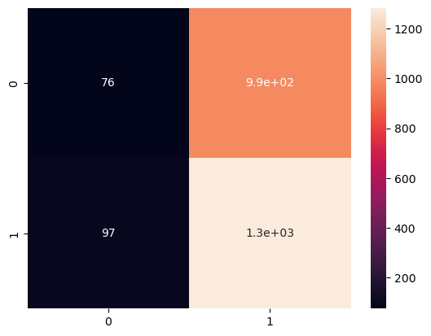
6. Create confusion Matrix #Age Confusion Matrix - verify accuracy of each class
Accuracy = 0.5558282208588957

Slide 14
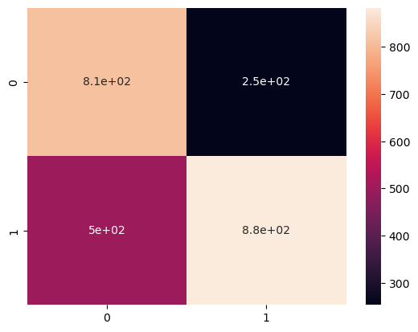
6. Create confusion Matrix #Gender Confusion Matrix - verify accuracy of each class
Accuracy = 0.6932515337423313

Slide 15
.
Best Model saved based on Validation Loss
Age Accuracy : 55%
Gender Accuracy : 77%

Slide 16

7. Test the model Input image from user to test the model Example process_and_predict('C:/Users/hm/Dropbox/My PC (LAPTOP-6M4OIP3C)/Pictures/WIN_20220524_13_31_21_Pro.jpg')
Age: 26
Gender: male

Slide 17
Real time Gender and Age Recognition by using webcam
Steps to follow:
Face detection with Haarcascade
Gender Recognition with CNN
1. Face detection with Haar cascades:
This is a part most of us at least have heard of. OpenCV provide direct methods to import Haarcascades and use them to detect faces.
2. Gender and Age Recognition with CNN :
CNN algorithm is used for Gender and age recognition. The CNN’s output layer (probability layer) in this CNN consists of two classes ‘Male’ or ‘Female’ and age .

Slide 18
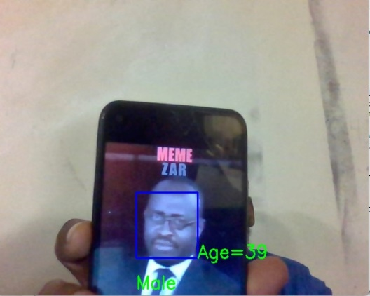

Slide 19
Challenges
Deciding no of layers
Deciding on different parameters in layers, Compile
Deciding on number of epochs
Saving checkpoint

Slide 20
CNN
Less time to Run
Epochs:5
Layers:3 CNN layers & 3 dense layers
Accuracy : Age- 55%,Gender-77%

Slide 21
Conclusion
we proposed a model to Classify the gender by feeding the CNN image dataset, a deep learning algorithm and trained in broad database face-recognition. In all, we think that the accuracy of the model is decent. but can be further improved by using more data, data increase and better network architecture.

